Slide 1
The Normal Distribution

Slide 2
Gaussian Random Variables
Bell-shaped curves appear in many applications of probability theory.
The probability models in these applications are members of the family of Gaussian random variables.
Because they occur so frequently in practice,
Gaussian random variables
are sometimes referred to as normal random variables.

Slide 3
Gaussian Random Variable

Slide 4
The Normal Distribution: as mathematical function (pdf)
This is a bell shaped curve with different centers and spreads depending on μ and σ
Note constants:
π=3.14159
e=2.71828

Slide 5
The Normal PDF
It’s a probability function, so no matter what the values of μ and σ, must integrate to 1!
Notes:
<number>

Slide 6
Normal distribution is defined by its mean and standard dev.
E(X)=μ =
Var(X)=σ² =
Standard Deviation(X)=σ

Slide 7
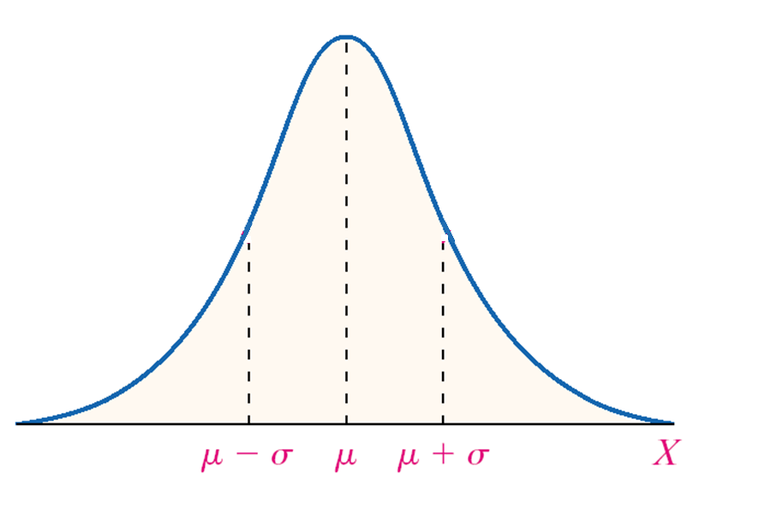
Notes:
<number>

Slide 8
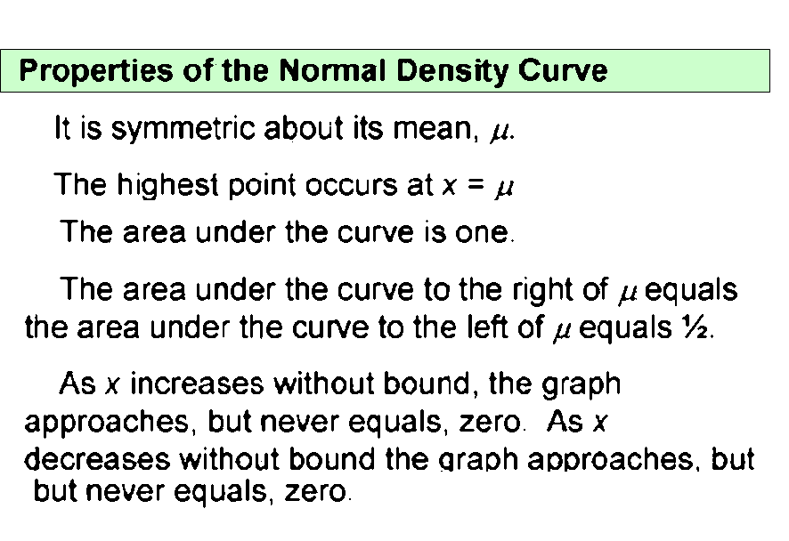

Slide 10
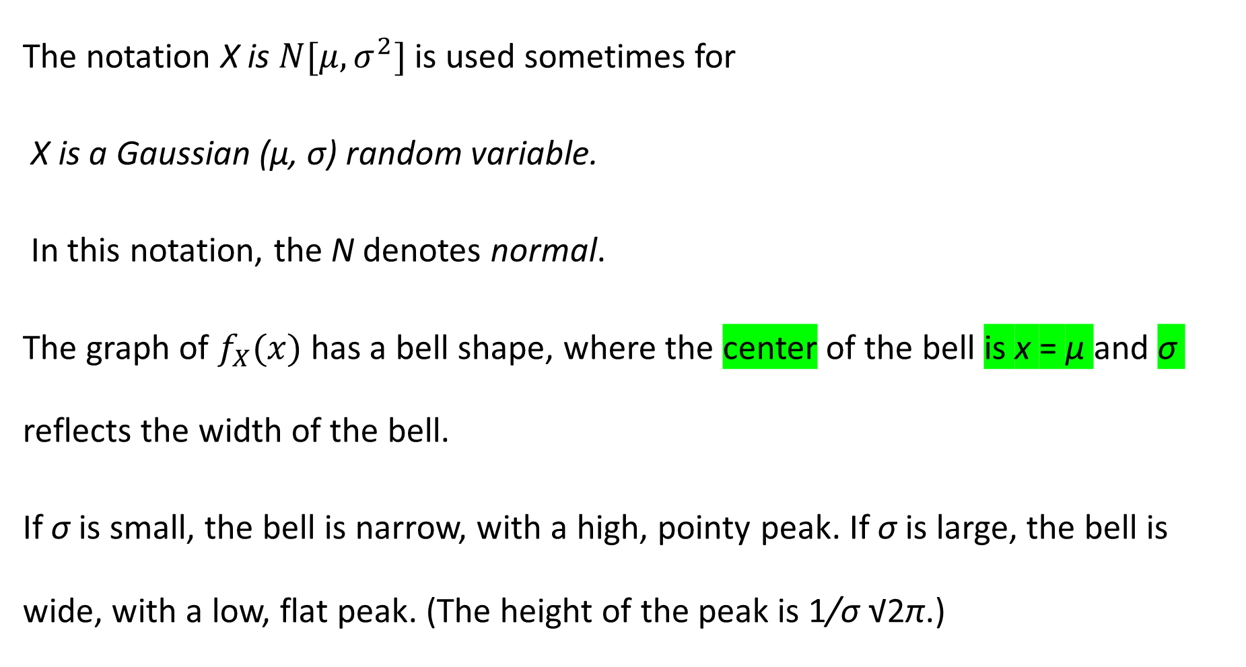
The notation X is is used sometimes for
X is a Gaussian (μ, σ) random variable.
In this notation, the N denotes normal.
The graph of has a bell shape, where the center of the bell is x = μ and σ reflects the width of the bell.
If σ is small, the bell is narrow, with a high, pointy peak. If σ is large, the bell is wide, with a low, flat peak. (The height of the peak is 1/σ √2π.)

Slide 11
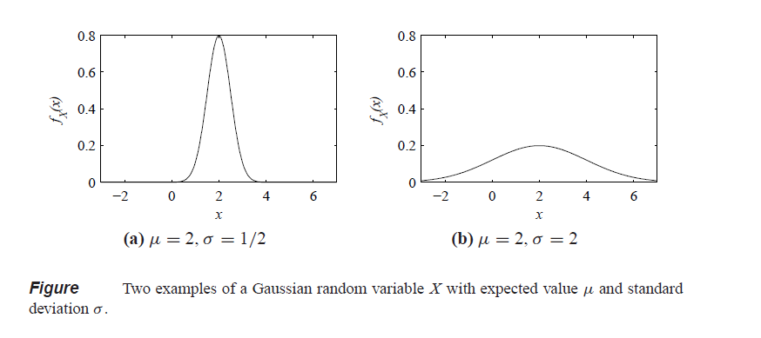
Figure contains two examples of Gaussian
PDFs with μ = 2. In Figure (a), σ = 0.5, and in Figure (b), σ = 2.

Slide 12
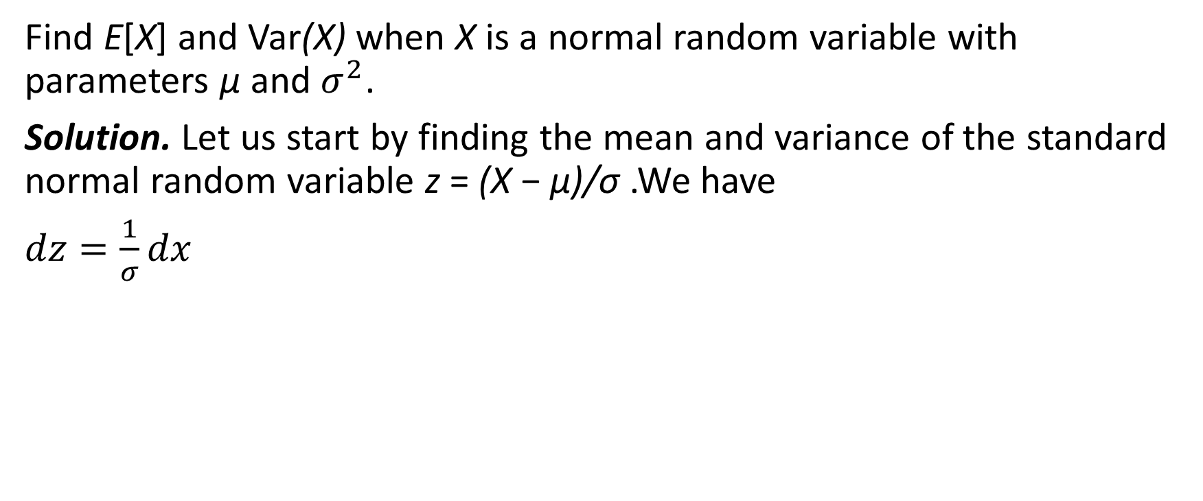
Find E[X] and Var(X) when X is a normal random variable with parameters μ and .
Solution. Let us start by finding the mean and variance of the standard normal random variable z = (X − μ)/σ .We have

Slide 13
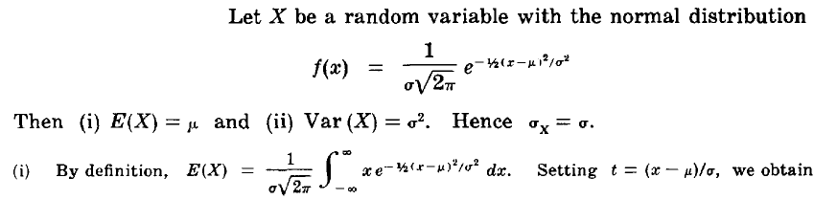

Slide 14
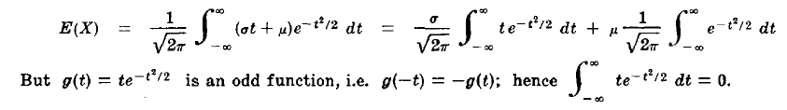



As
=

Slide 15
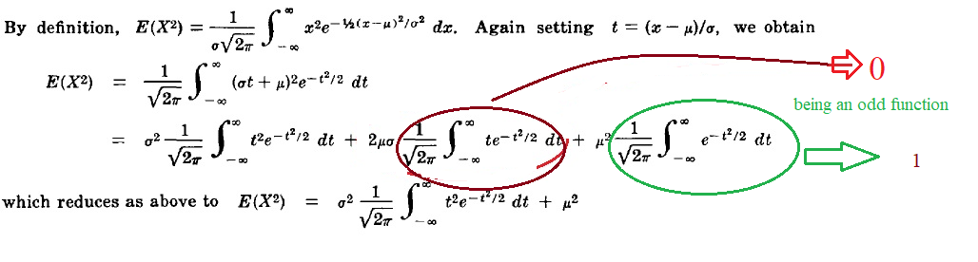

Slide 16
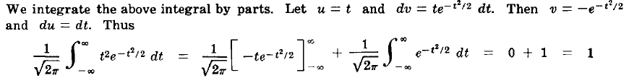
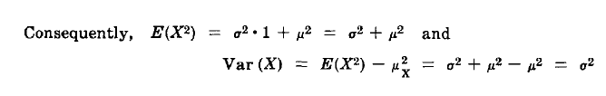

Slide 17
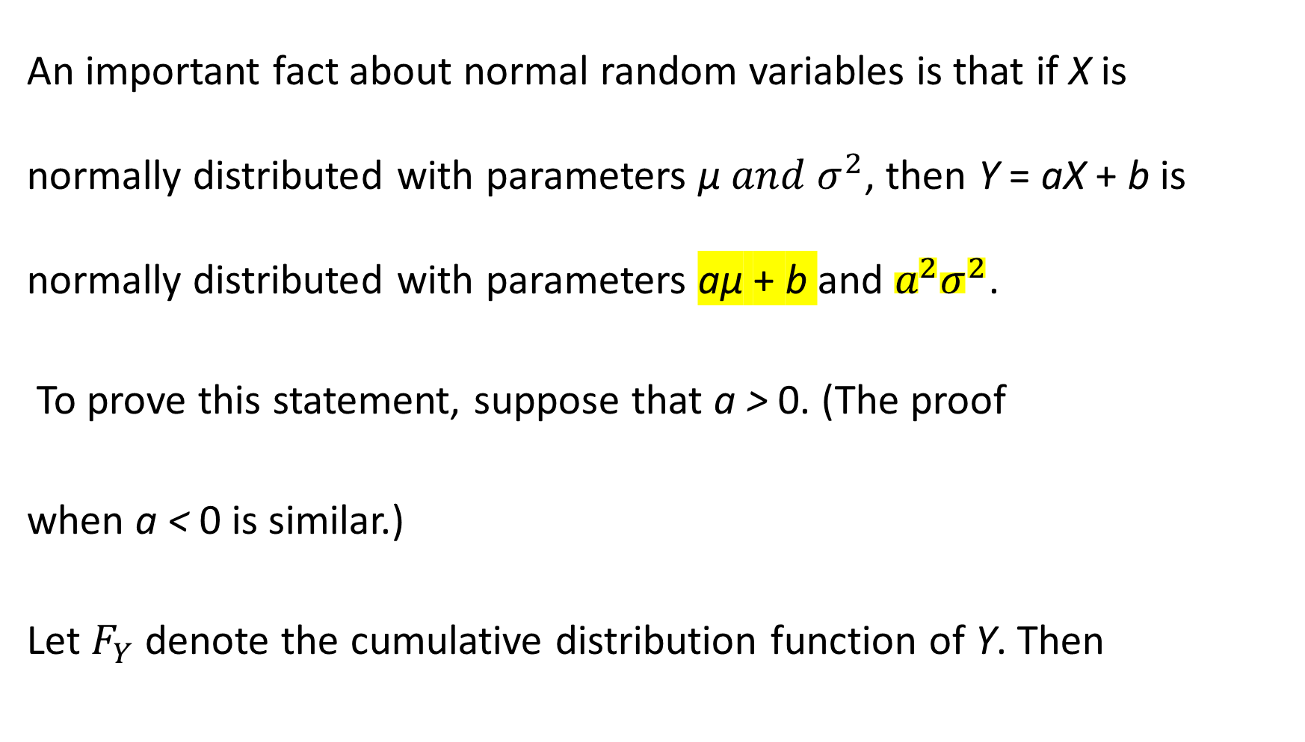
An important fact about normal random variables is that if X is normally distributed with parameters μ , then Y = aX + b is normally distributed with parameters aμ + b and .
To prove this statement, suppose that a > 0. (The proof
when a < 0 is similar.)
Let denote the cumulative distribution function of Y. Then

Slide 18
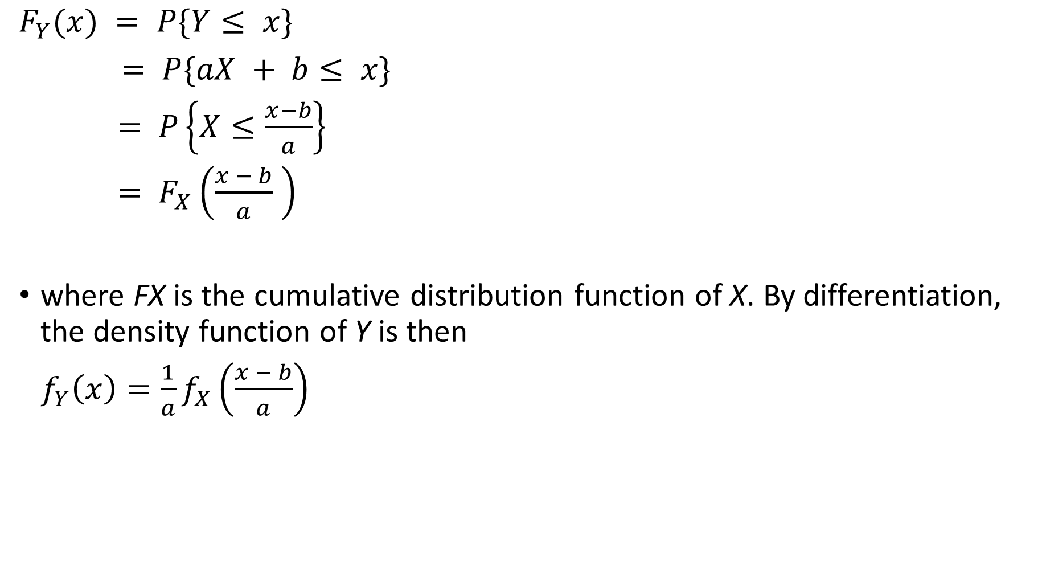
where FX is the cumulative distribution function of X. By differentiation, the density function of Y is then

Slide 19
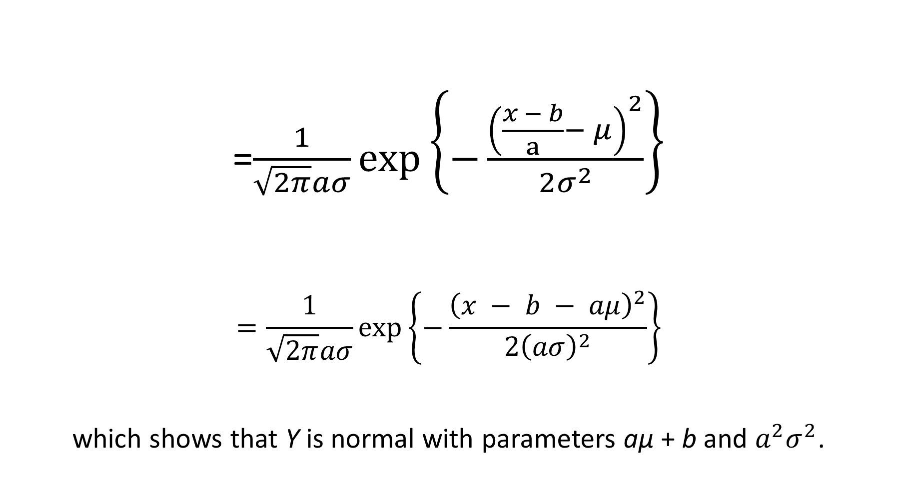
=
which shows that Y is normal with parameters aμ + b and .

Slide 20
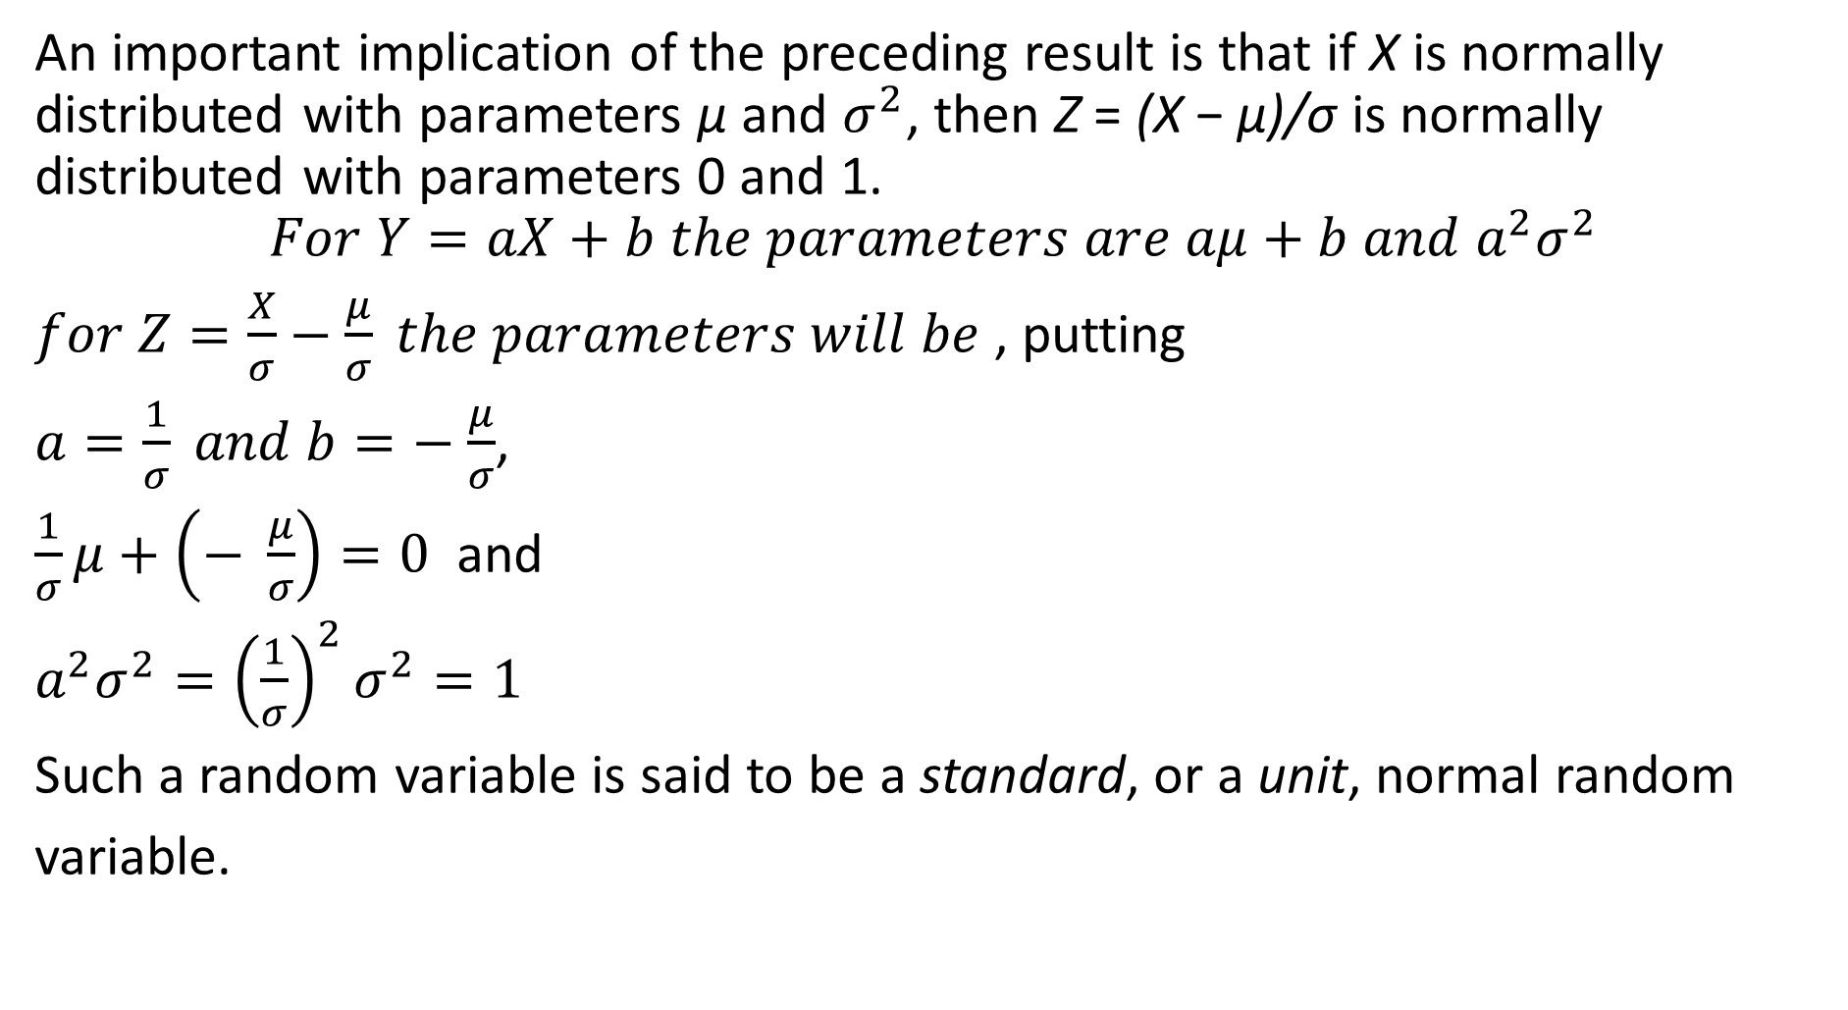
An important implication of the preceding result is that if X is normally distributed with parameters μ and , then Z = (X − μ)/σ is normally distributed with parameters 0 and 1.
, putting
,
and
Such a random variable is said to be a standard, or a unit, normal random
variable.

Slide 22
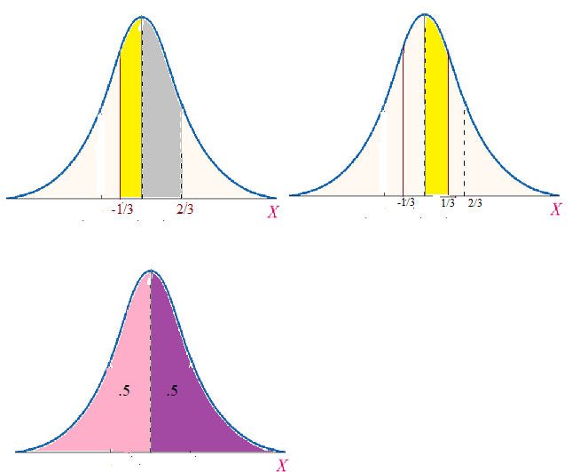

Slide 23
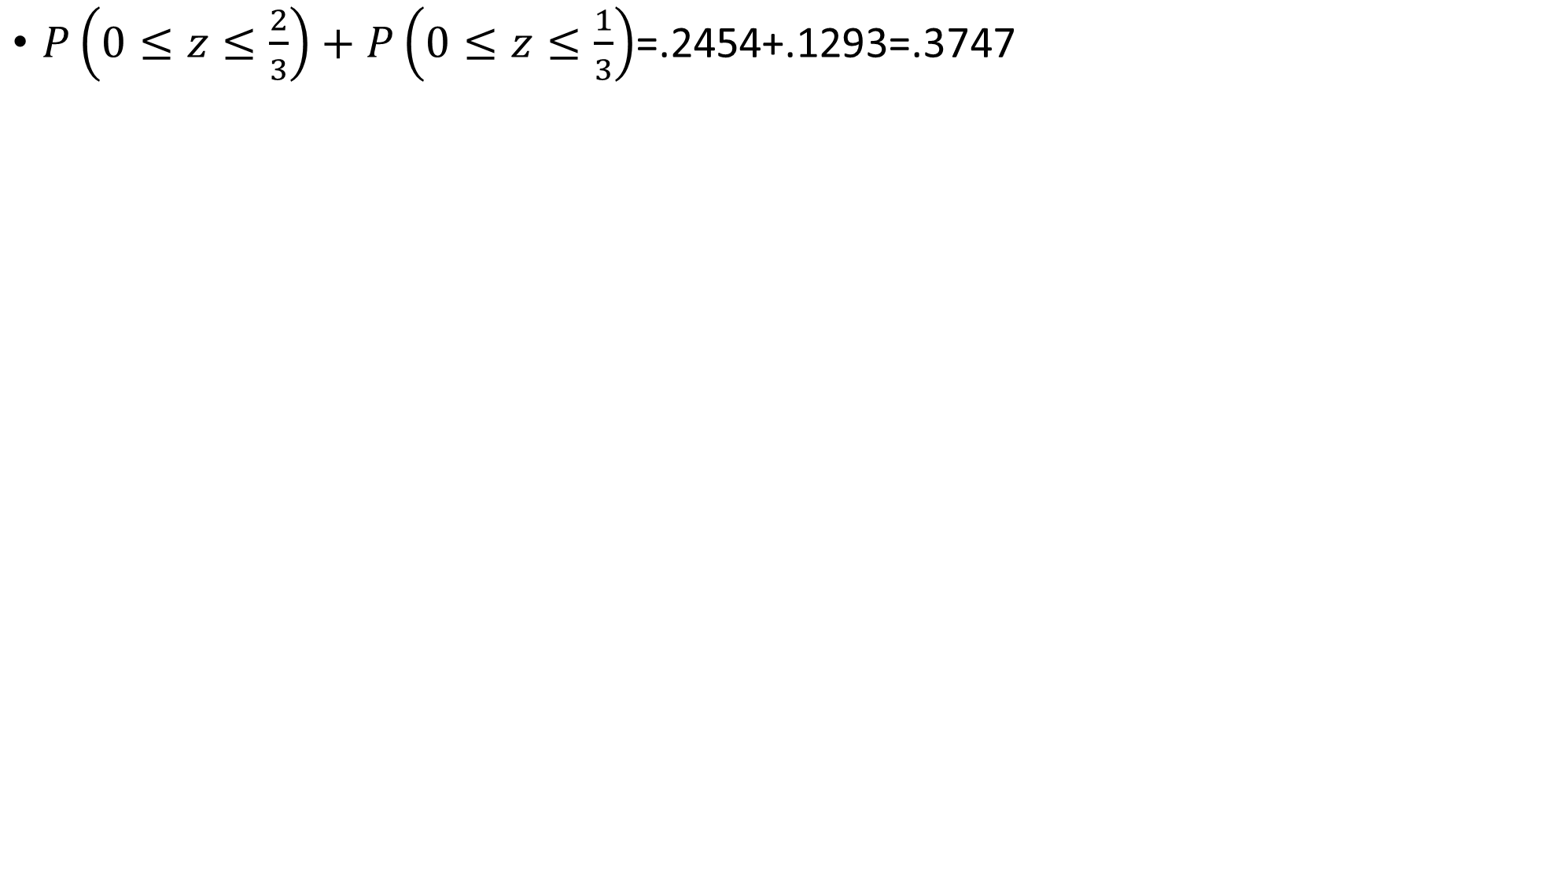
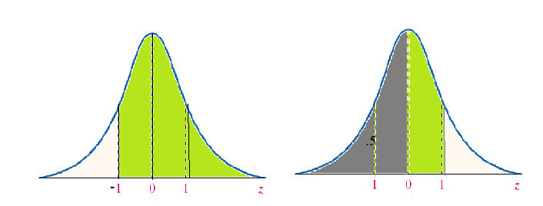
=.2454+.1293=.3747
.5000+.3413=.8413

Slide 24
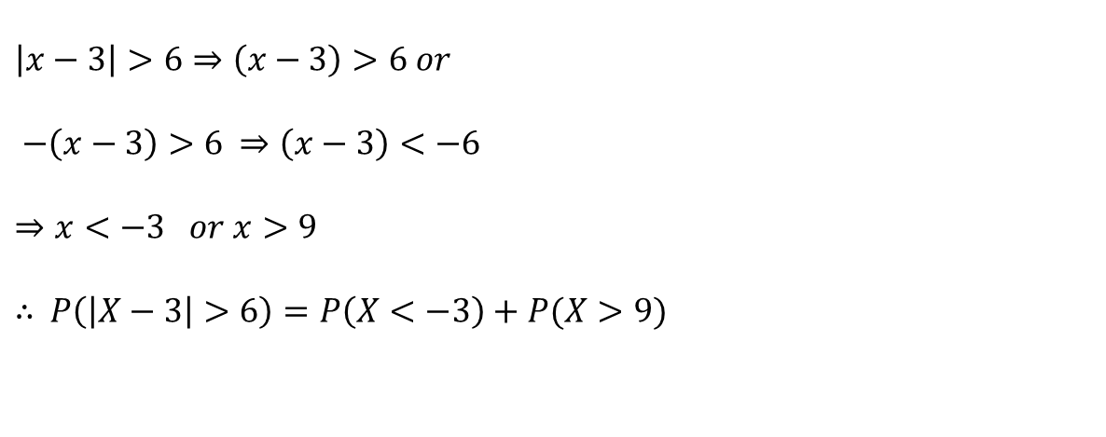
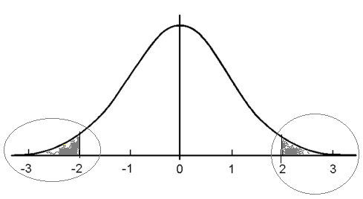

Slide 25
=.5000-(P(0<Z<2)+.5000-(P(0<Z<2)= 2(.5000-.4772)=2 X .0228=.0456

Slide 26
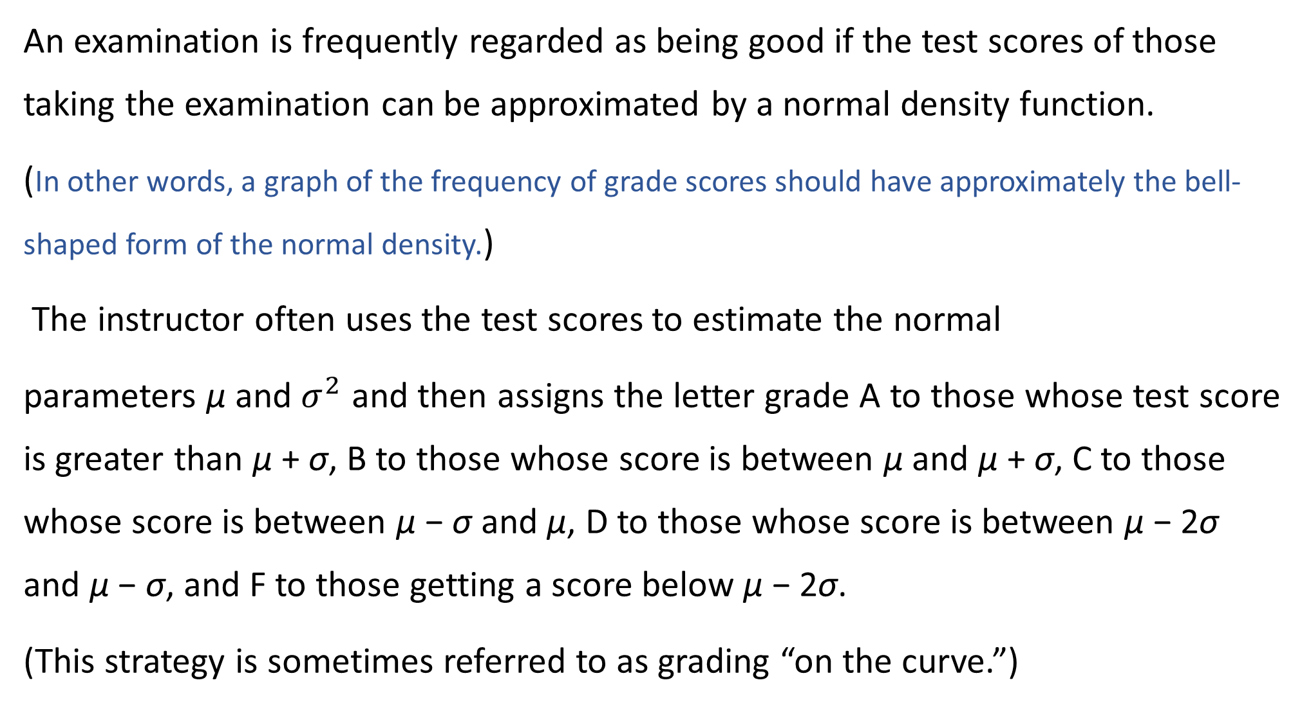

Slide 27
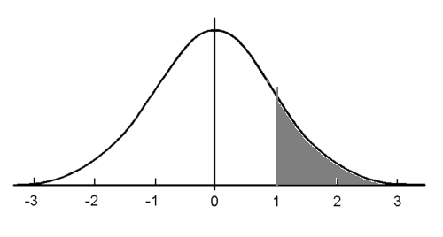
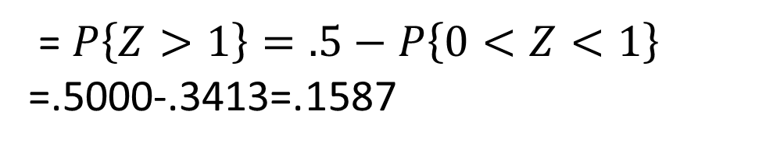
=
=.5000-.3413=.1587

Slide 28
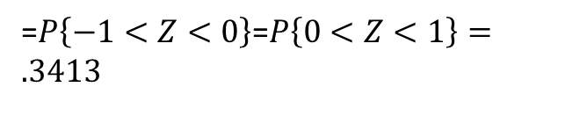
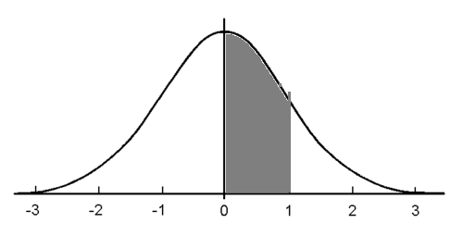
=
=

Slide 29
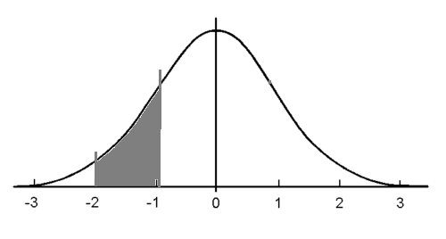
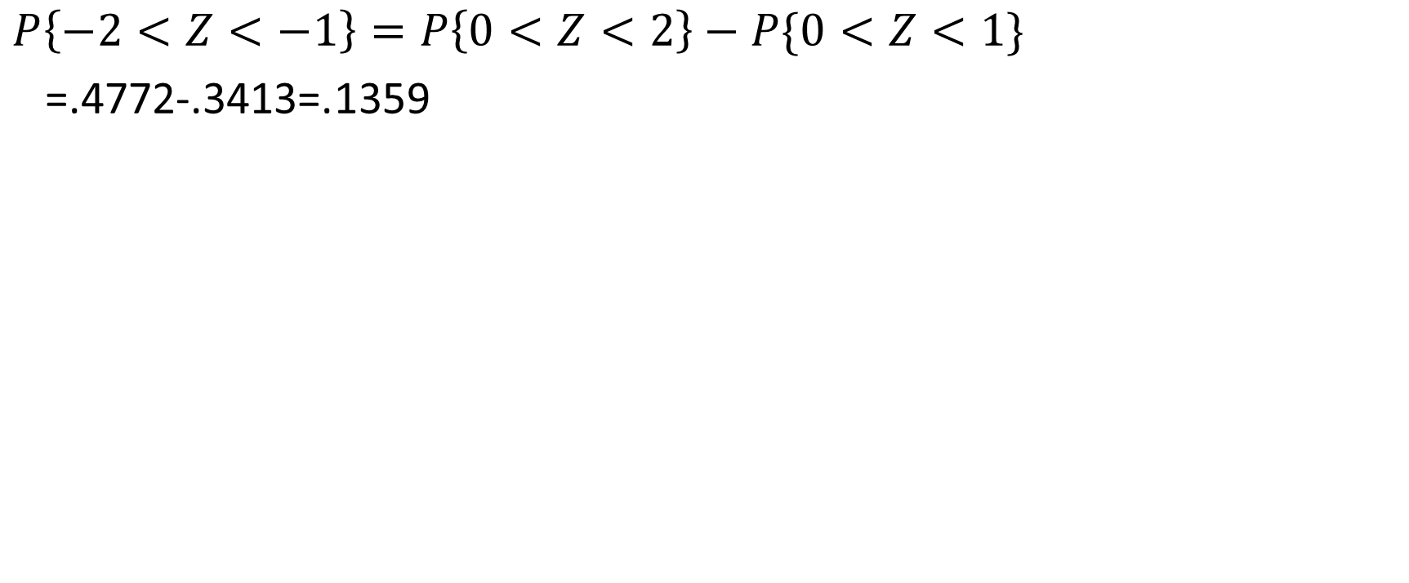

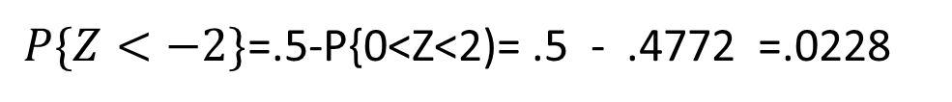
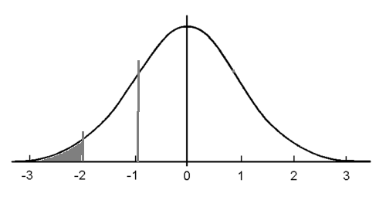
=.4772-.3413=.1359
=.5-P{0<Z<2)= .5 - .4772 =.0228

Slide 30
it follows that approximately 16 percent of the class will receive an A grade on the examination,
34 percent a B grade,
34 percent a C grade, and
14 percent a D grade;
2 percent will fail.

Slide 31
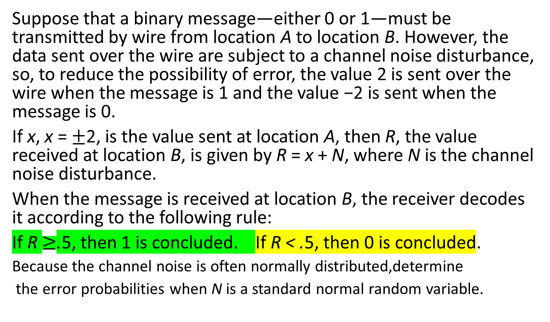

Slide 32
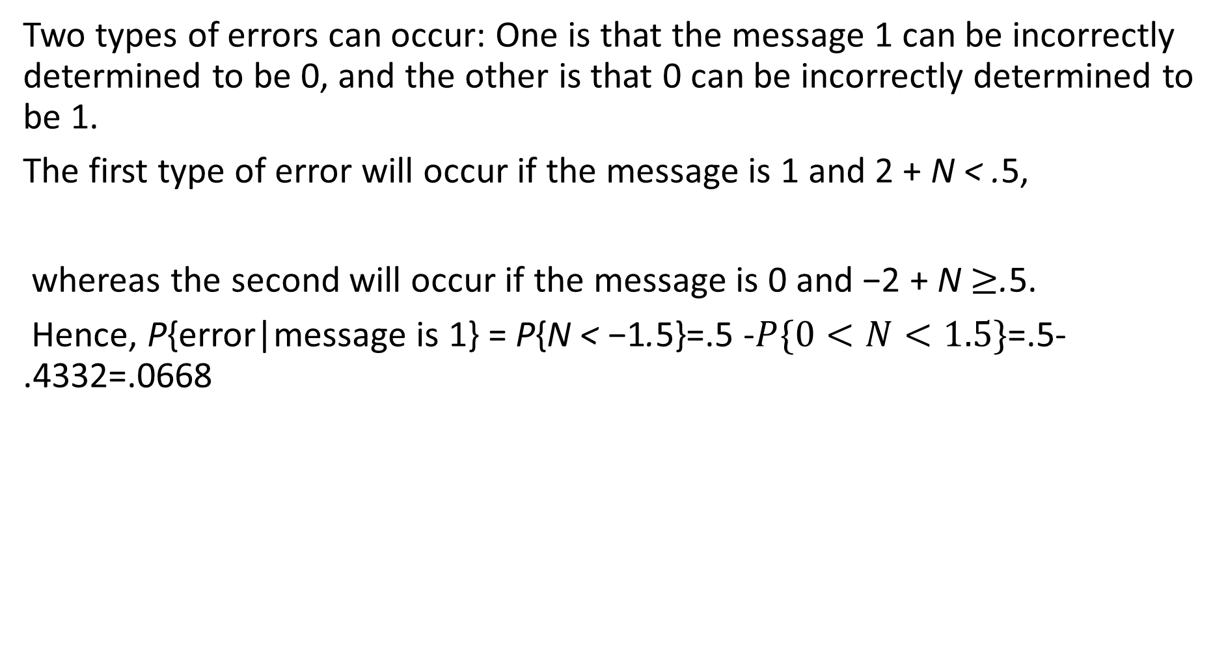
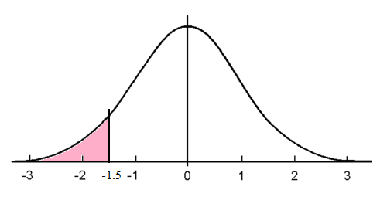

Slide 33
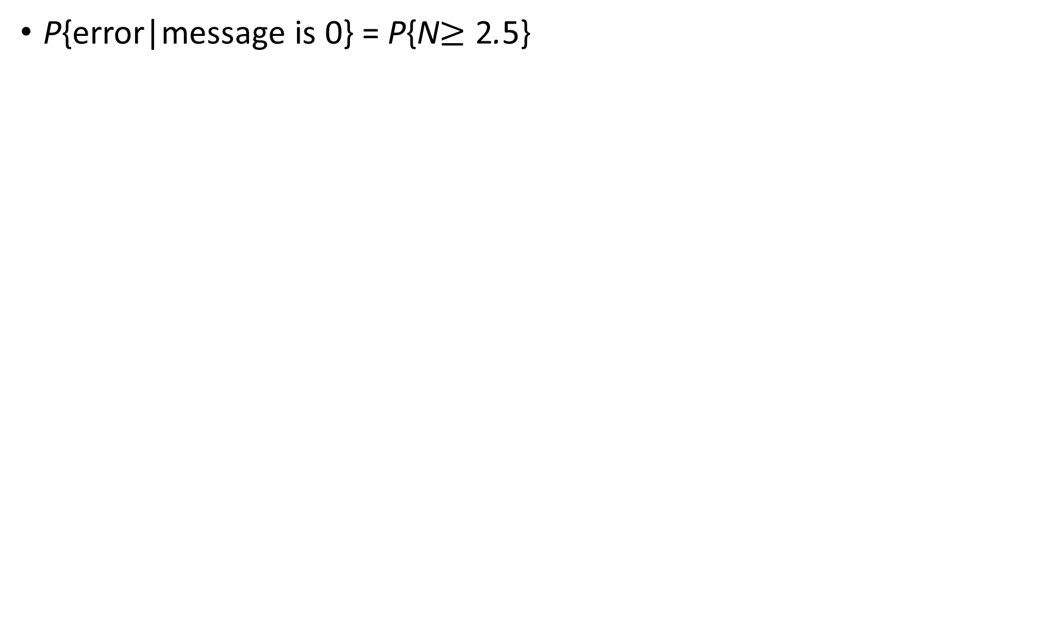
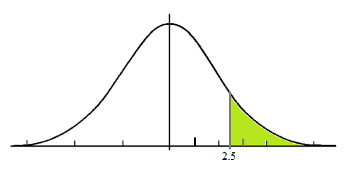
P{error|message is 0} = P{N 2.5}
=.5-P(0<N<2.5)=.5-.4938= .0062

Slide 34
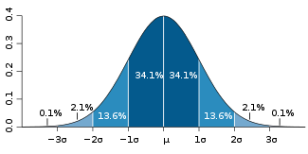

One standard deviation away from the mean ( ) in either direction on the horizontal axis accounts for around 68 percent of the data. Two standard deviations away from the mean accounts for roughly 95 percent of the data with three standard deviations representing about 99.7 percent of the data.

Slide 35
Standard Normal Distribution
The mean of the data in a standard normal distribution is 0 and the standard deviation is 1.
A standard normal distribution is the set of all z-scores.

Slide 36
z-scores
When a set of data values are normally distributed, we can standardize each score by converting it into a z-score.
z-scores make it easier to compare data values measured on different scales.

Slide 37
z-scores
A z-score reflects how many standard deviations above or below the mean a raw score is.
The z-score is positive if the data value lies above the mean and negative if the data value lies below the mean.

Slide 38
z-score formula
Where x represents an element of the data set, the mean is represented by and standard deviation by .

Slide 39
Analyzing the data
Suppose SAT scores among college students are normally distributed with a mean of 500 and a standard deviation of 100. If a student scores a 700, what would be her z-score?
Her z-score would be 2 which means her score is two standard deviations above the mean.

Slide 40
Analyzing the data
A set of math test scores has a mean of 70 and a standard deviation of 8.
A set of English test scores has a mean of 74 and a standard deviation of 16.
For which test would a score of 78 have a higher standing?

Slide 41
Analyzing the data
A set of math test scores has a mean of 70 and a standard deviation of 8.
A set of English test scores has a mean of 74 and a standard deviation of 16.
For which test would a score of 78 have a higher standing?
To solve: Find the z-score for each test.
The math score would have the highest standing since it is 1 standard deviation above the mean while the English score is only .25 standard deviation above the mean.

Slide 42
Analyzing the data
What will be the miles per gallon for a Toyota Camry when the average mpg is 23, it has a z value of 1.5 and a standard deviation of 5?

Slide 43
Analyzing the data
What will be the miles per gallon for a Toyota Camry when the average mpg is 23, it has a
z value of 1.5 and a standard deviation of 2?
Using the formula for z-scores:
The Toyota Camry would be expected to use 26 mpg of gasoline.

Slide 44
EXAMPLE A Normal Random Variable
The following data represent the heights (in inches) of a random sample of 50 two-year old persons.
(a) Create a relative frequency distribution with the lower class limit of the first class equal to 31.5 and a class width of 1.
(b) Draw a histogram of the data.
(c ) Do you think that the variable “height of 2-year old people” is normally distributed?
Notes:
<number>

Slide 45
36.0 36.2 34.8 36.0 34.6 38.4 35.4 36.8
34.7 33.4 37.4 38.2 31.5 37.7 36.9 34.0
34.4 35.7 37.9 39.3 34.0 36.9 35.1 37.0
33.2 36.1 35.2 35.6 33.0 36.8 33.5 35.0
35.1 35.2 34.4 36.7 36.0 36.0 35.7 35.7
38.3 33.6 39.8 37.0 37.2 34.8 35.7 38.9
37.2 39.3
Notes:
<number>

Slide 46
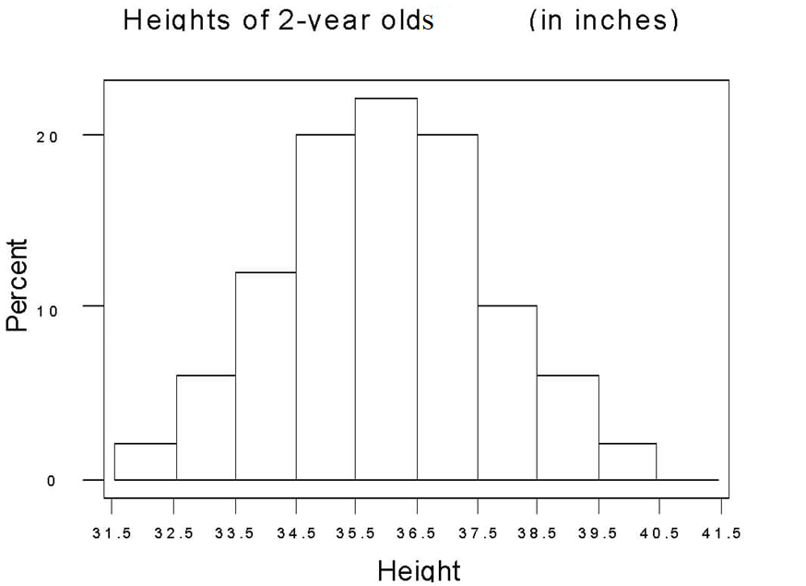
Notes:
<number>

Slide 47
In the next slide, there is a normal density curve drawn over the histogram. How does the area of the rectangle corresponding to a height between 34.5 and 35.5 inches relate to the area under the curve between these two heights?
Notes:
<number>

Slide 48
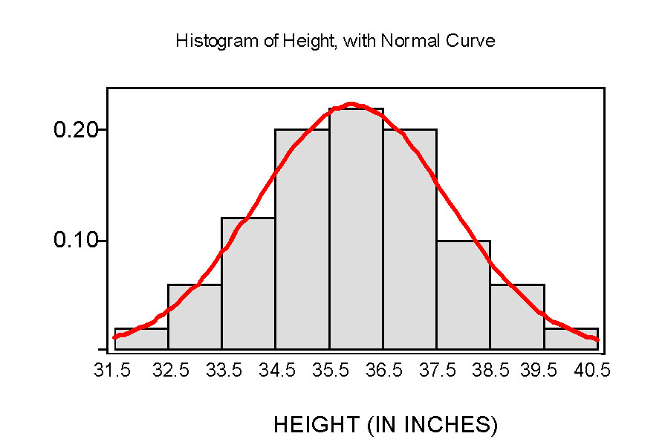
Notes:
<number>

Slide 49
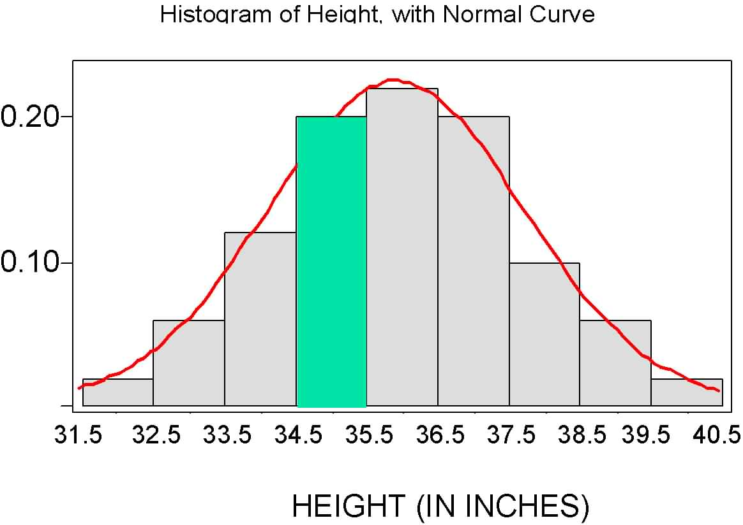
Notes:
<number>

Slide 50
The Standard Normal Distribution

Slide 51
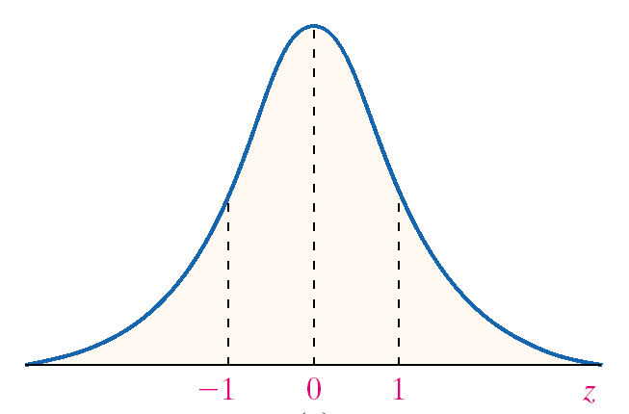
Notes:
<number>

Slide 52
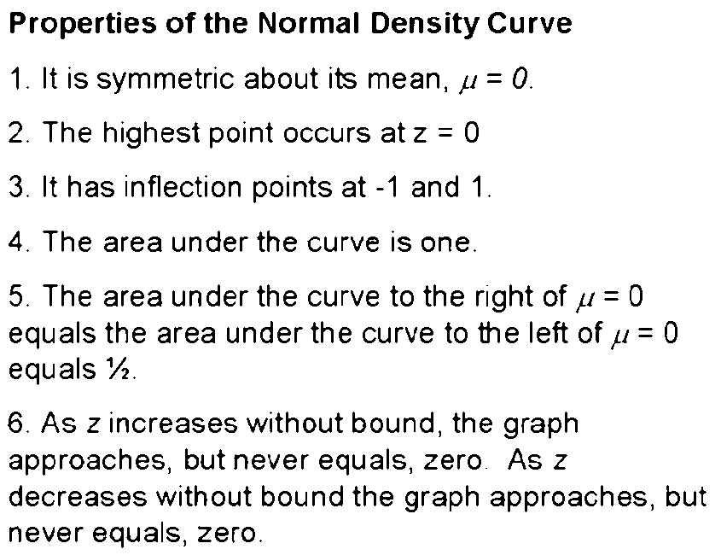
Notes:
<number>

Slide 53
Properties of the Normal Density Curve
7. The Empirical Rule: About 68% of the area under the graph is between -1 and 1; about 95% of the area under the graph is between -2 and 2; about 99.7% of the area under the graph is between -3 and 3.
Notes:
<number>

Slide 54
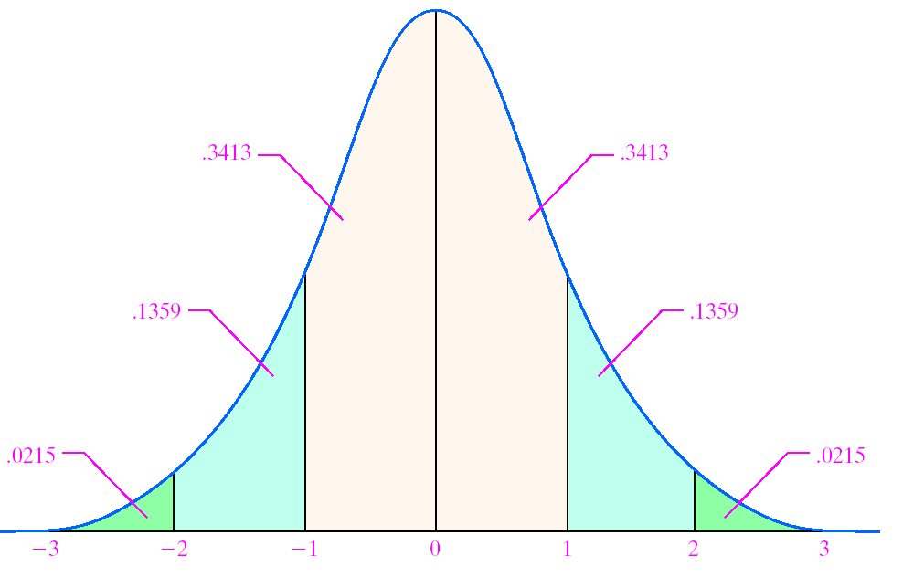
Notes:
<number>

Slide 55
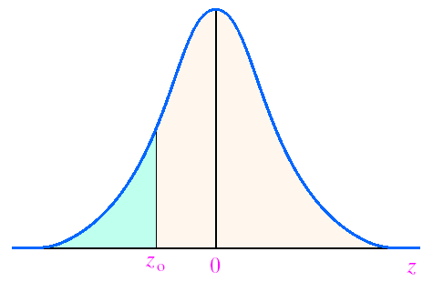
The table gives the area under the standard normal curve for values to the left of a specified Z-score, z_{o}, as shown in the figure.
Notes:
<number>

Slide 56
EXAMPLE Finding the Area Under the Standard Normal Curve
Find the area under the standard normal curve to the left of Z = -0.38.
Notes:
<number>

Slide 57
Area under the normal curve to the right of z_{o}
= 1 – Area to the left of z_{o}
Notes:
<number>

Slide 58
EXAMPLE Finding the Area Under the Standard Normal Curve
Find the area under the standard normal curve to the right of Z = 1.25.
Look in the Normal distribution table:
P(x>=1.25) =1-P(x<1.25)=1-0.8944=0.1056
Notes:
<number>

Slide 59
EXAMPLE Finding the Area Under the Standard Normal Curve
Find the area under the standard normal curve between Z = -1.02 and Z = 2.94.
P(-1.02<x<2.94)=P(x<2.94)-p(x<-1.02)
=0.9984-0.1539
=0.8445
Notes:
<number>

Slide 60
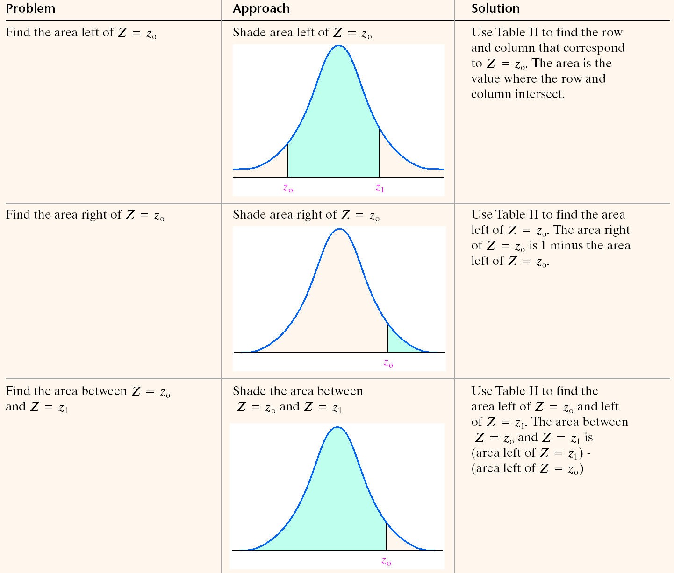
Notes:
<number>

Slide 61
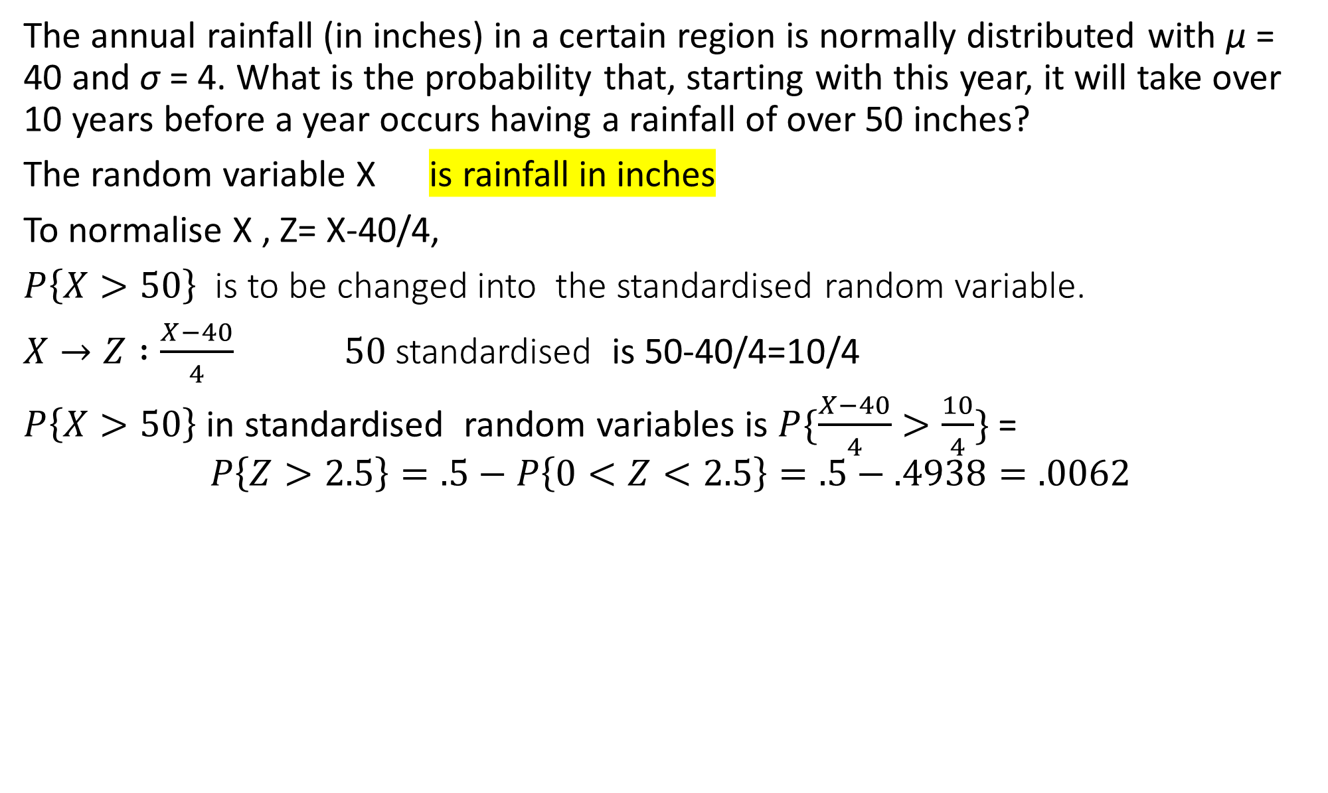
The annual rainfall (in inches) in a certain region is normally distributed with μ = 40 and σ = 4. What is the probability that, starting with this year, it will take over 10 years before a year occurs having a rainfall of over 50 inches?
The random variable X is rainfall in inches
To normalise X , Z= X-40/4,
is to be changed into the standardised random variable.
standardised is 50-40/4=10/4
in standardised random variables is =

Slide 62
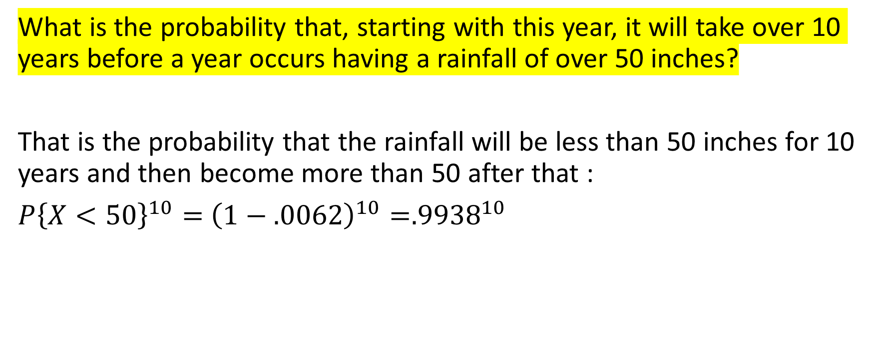
What is the probability that, starting with this year, it will take over 10 years before a year occurs having a rainfall of over 50 inches?
That is the probability that the rainfall will be less than 50 inches for 10 years and then become more than 50 after that :

